Slide 1
Day 2 Course
By
Sridhar S

Slide 2

Alert and budget
Alerts proactively notify you when important conditions are found in your monitoring data. They allow you to identify and address issues before the users of your system notice them.
Budgets in Cost Management help you plan for and drive organizational accountability. With budgets, you can account for the Azure services you consume or subscribe to during a specific period.
You can create a recurring task that automatically exports your Cost Management data to Azure storage on a daily, weekly, or monthly basis.
You can export the cost data in CSV

Slide 3

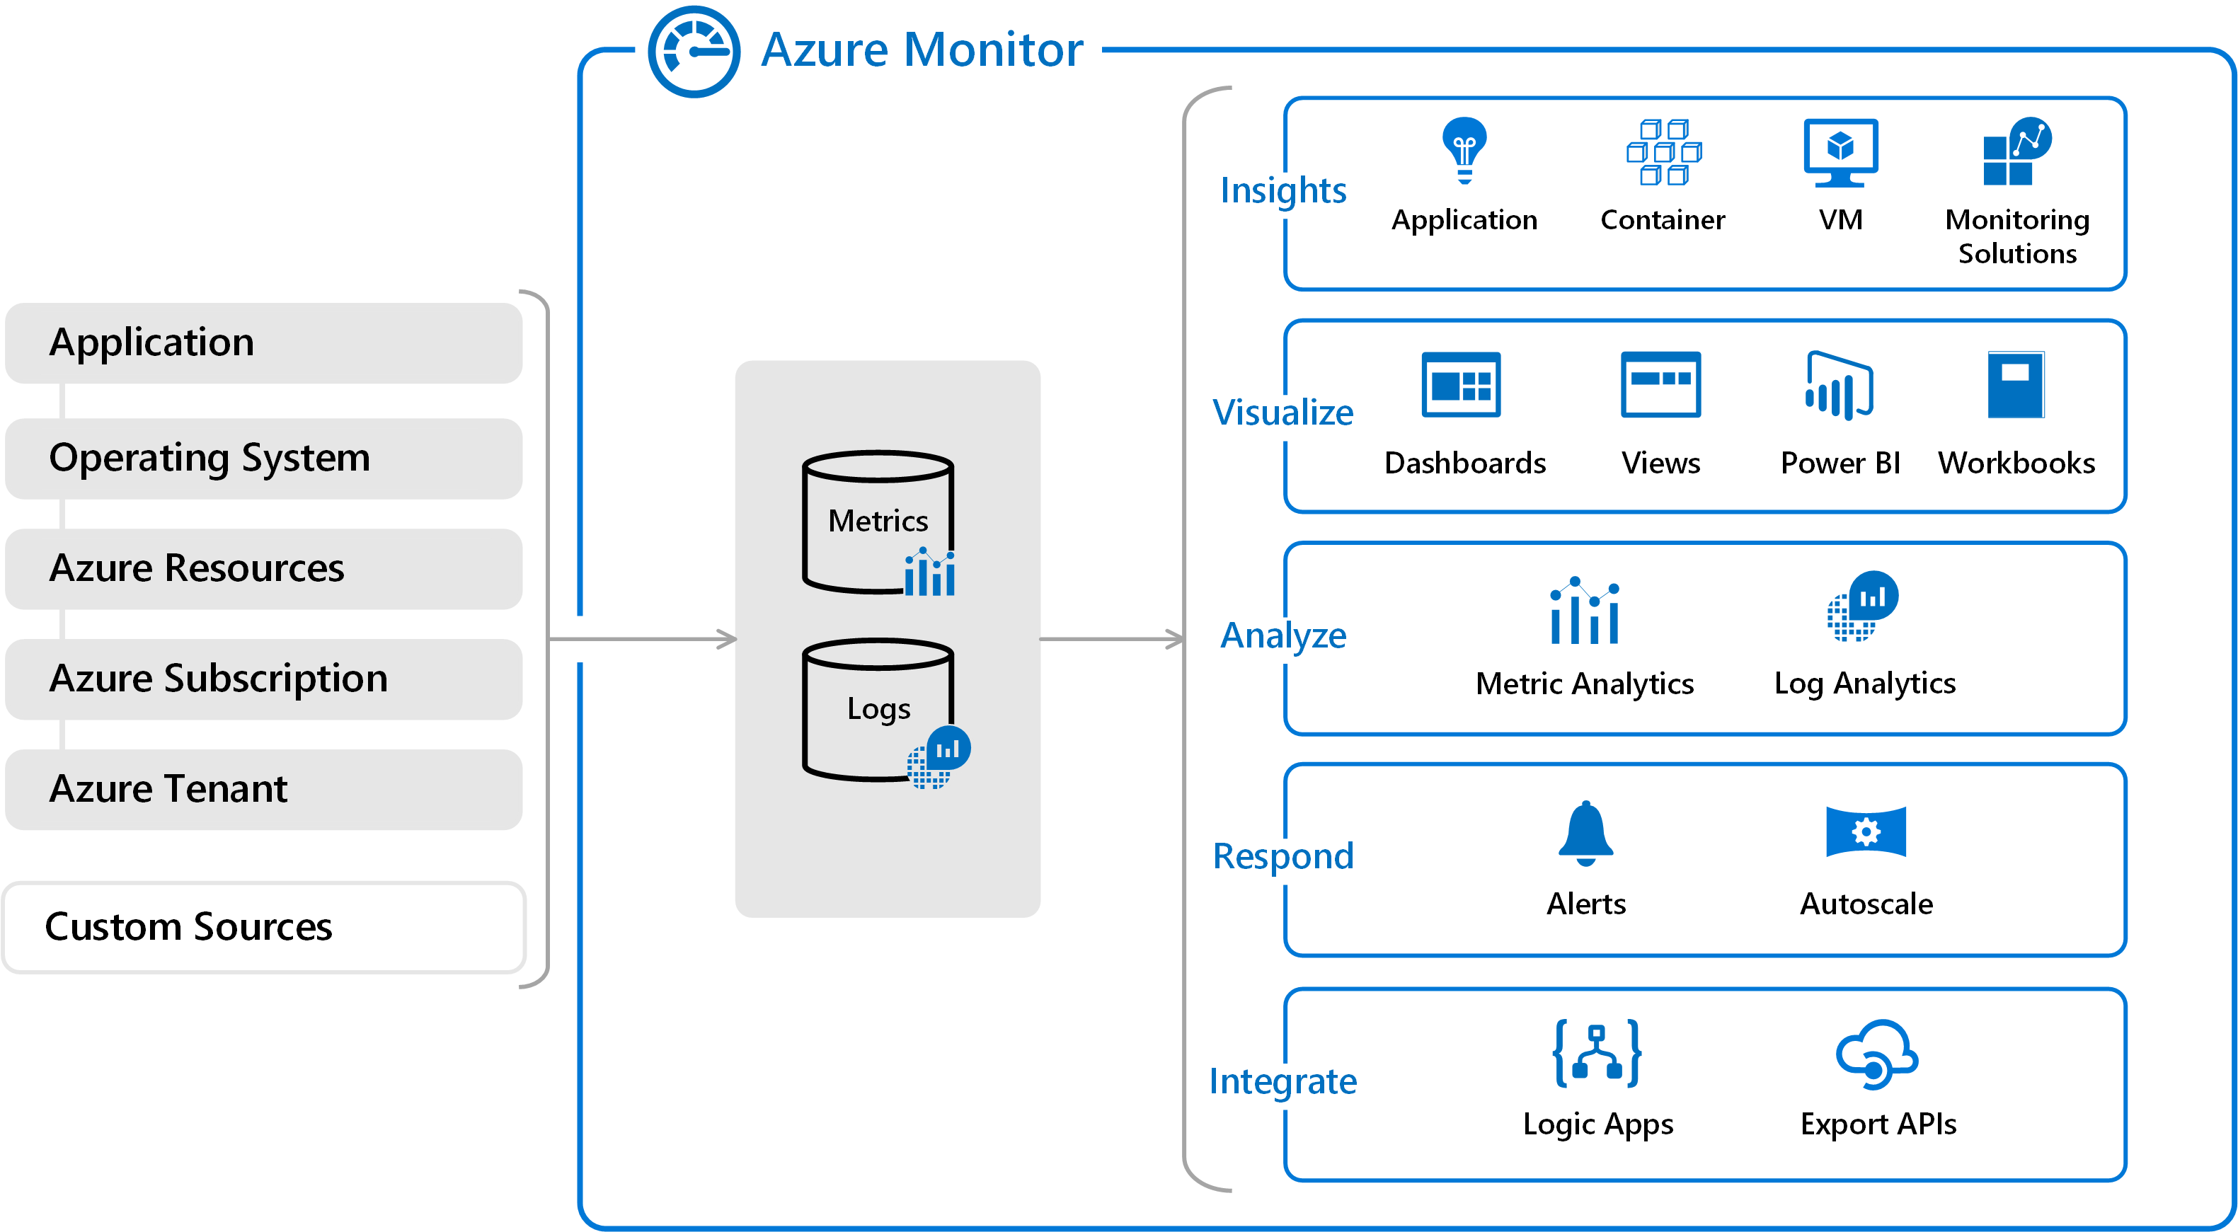
Azure Monitor
Azure Monitor maximizes the availability and performance of your applications and services by delivering a comprehensive solution for collecting, analyzing, and acting on telemetry from your cloud and on-premises environments.

Slide 4
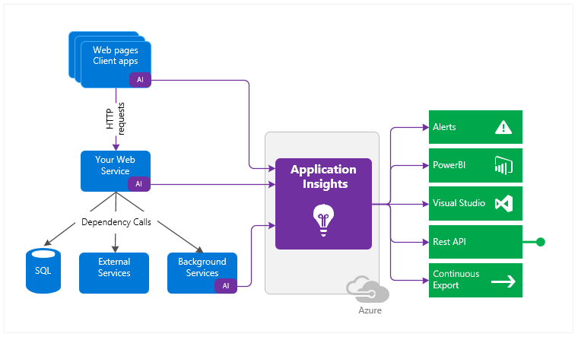
Application Insights
Application Insights monitors the availability, performance, and usage of your web applications whether they're hosted in the cloud or on-premises. It leverages the powerful data analysis platform in Azure Monitor to provide you with deep insights into your application's operations and diagnose errors without waiting for a user to report them.

Slide 5
What does Application Insights monitor
Request rates, response times, and failure rates
Dependency rates, response times, and failure rates
Exceptions
Page views and load performance
AJAX calls
User and session counts.
Performance counters
Host diagnostics
Diagnostic trace logs
Custom events and metrics

Slide 6
Azure Diagnostics
Azure Diagnostics extension is an agent in Azure Monitor that collects monitoring data from the guest operating system of Azure compute resources including virtual machines.
The Log Analytics agent in Azure Monitor can also be used to collect monitoring data from the guest operating system of virtual machines. You may choose to use either or both depending on your requirements.
The key differences to consider are:
Azure Diagnostics Extension can be used only with Azure virtual machines. The Log Analytics agent can be used with virtual machines in Azure, other clouds, and on-premises.
Azure Diagnostics extension sends data to Azure Storage, Azure Monitor Metrics (Windows only) and Event Hubs. The Log Analytics agent collects data to Azure Monitor Logs.
The Log Analytics agent is required for solutions, Azure Monitor for VMs, and other services such as Azure Security Center.

Slide 7
Log Analytics
The Azure Log Analytics agent was developed for comprehensive management across virtual machines in any cloud, on-premises machines, and those monitored by System Center Operations Manager.
The key differences to consider are: (https://docs.microsoft.com/en-us/azure/azure-monitor/platform/log-analytics-agent)
Azure Diagnostics Extension can be used only with Azure virtual machines. The Log Analytics agent can be used with virtual machines in Azure, other clouds, and on-premises.
Azure Diagnostics extension sends data to Azure Storage, Azure Monitor Metrics (Windows only) and Event Hubs. The Log Analytics agent collects data to Azure Monitor Logs.
The Log Analytics agent is required for solutions, Azure Monitor for VMs, and other services such as Azure Security Center.

Slide 8
Deploy a template
$resourceGroupName = Read-Host -Prompt "testing“
$location = Read-Host -Prompt "East US“
New-AzResourceGroup -Name $resourceGroupName -Location $location New-AzResourceGroupDeployment -ResourceGroupName $resourceGroupName ` -TemplateFile c:\MyTemplates\azuredeploy.json
New-AzResourceGroupDeployment -ResourceGroupName $resourceGroupName ` -TemplateUri https://raw.githubusercontent.com/Azure/azure-quickstart-templates/master/101-storage-account-create/azuredeploy.json
New-AzResourceGroupDeployment -Name ExampleDeployment -ResourceGroupName ExampleResourceGroup ` -TemplateUri https://raw.githubusercontent.com/Azure/azure-quickstart-templates/master/101-storage-account-create/azuredeploy.json ` -TemplateParameterUri https://raw.githubusercontent.com/Azure/azure-quickstart-templates/master/101-storage-account-create/azuredeploy.parameters.json

